Slide 1

F1 FlashBack Visualization
Shaohua Yue
Xinyu Zhou
Zihao Qian

Slide 2

CAR STAT DISPLAY
REAL TIME RANKING

Slide 3

Real-time Ranking
Function: Displays the real-time ranking of drivers
Challenge: How to calculate ranking on a circular track

Slide 4

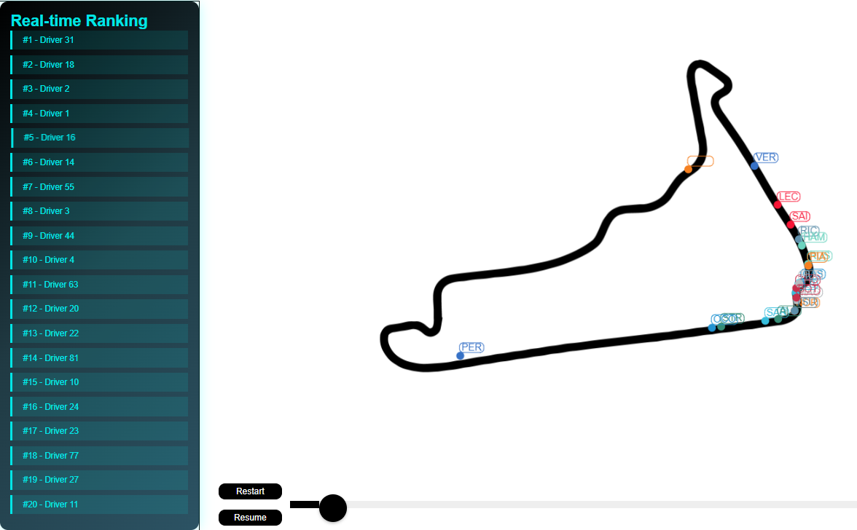

Slide 5
CAR STAT DISPLAY

Slide 6

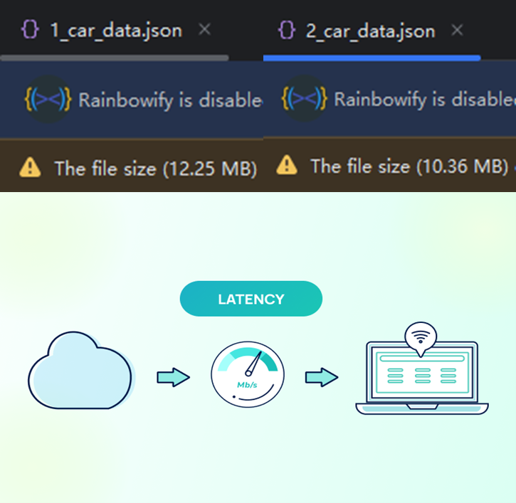
PROBLEMS
Oversized files
Limited bandwidth
Latency sensitive

Slide 7
SOLUTIONS
File slicing: Slice a unified & big file into small batches based on durations. Client only fetches when a batch is needed.
Generic fetch: Search via timestamp in client browser cache first, fetch a new batch from the web server if a cache miss occurred.

Slide 8
Cache file
async then
Fetch file
Return empty data
miss
Render
Find file via index.json
in cache
Query
via datetime
Binary search for data
Return latest available data
hit

